Slide 1
Introduction to Data Structures: Circular Linked List
By Mr. Zukile Ndyalivana

Slide 2
Circular Linked List is little more complicated linked data structure.
In the circular linked list:
We can insert elements anywhere in the list
Whereas in the array for instance:
We cannot insert elements anywhere in the list because it is in the contiguous memory.
In the circular linked list :
The previous element stores the address of the next element
And the last element stores the address of the starting element.

Slide 3
The elements point to each other in a circular way which forms a circular chain.
The circular linked list has a dynamic size
which means the memory can be allocated when it is required.

Slide 4
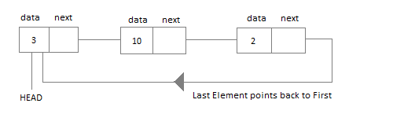
3
12
16

Slide 5
Application of Circular Linked List
The real life application where the circular linked list is used is our Personal Computers,
Where multiple applications are running.
All the running applications are kept in a circular linked list
And the OS gives a fixed time slot to all for running.
The Operating System keeps on iterating over the linked list until all the applications are completed.

Slide 6
Another example:
Multiplayer games
All the Players are kept in a Circular Linked List and the pointer keeps on moving forward as a player's chance ends.
Circular Linked List can also be used:
to create Circular Queue.
In a Queue we have to keep two pointers, FRONT and REAR in memory all the time,
Where as in Circular Linked List,
only one pointer is required.

Slide 7
NOTE, Any node can be a starting point.
We can traverse the whole list by starting from any point.
We just need to stop when the first visited node is visited again.

Slide 8
There are 2 Types of Circular Linked Lists:
Singly Circular Linked List
Doubly Circular Linked List

Slide 9
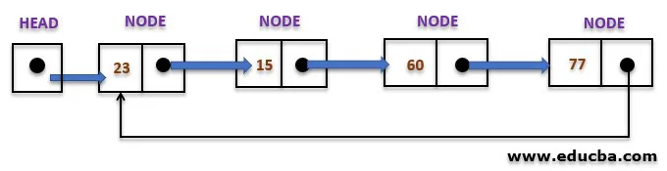
Singly Circular Linked List
The type of circular linked list whose every node has a pointer to its next node only is known as a singly circular linked list.

Slide 10
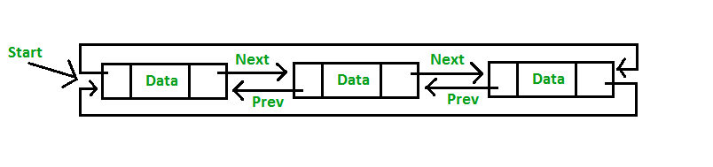
Circular Doubly Linked List has properties of both doubly linked list and circular linked list in which two consecutive elements are linked or connected by previous and next pointer
And the last node points to first node by next pointer and also the first node points to last node by previous pointer.

Slide 11
Advantages of Circular Linked List
Very effective for the implementation of queue.
The queue data structure implementation in Java:
Uses a circular linked list as its internal implementation.
Furthermore
there is no need to maintain two pointers for front and rear
especially if we use circular linked list.
We can maintain a pointer to the last inserted node and front can always be obtained as next of last.
N.B
Any node can be a starting point.
We can traverse the whole list by starting from any point.

Slide 12
We just need to stop when the first visited node is visited again.
Circular Doubly Linked Lists are used for implementation of advanced data structures like Fibonacci Heap.

Slide 13
There are many computer science problems that
Are by nature circular:
E.g. the Round-robin scheduling algorithm
N.B:
The complete list can be traversed starting with any node.

Slide 14
Drawbacks
Depending on the implementation:
Doing insertion at start of list would require doing a search for the last node which could be expensive.

Slide 15
As we know
there exist quite a number of data structures
like arrays,
linked lists, etc.
The arrangement of these data structures have their strengths and weaknesses.

Slide 16
For these reasons,
Therefore it is important to know the
Benefits and drawbacks of different data structures
Why?
Because we want to be good at designing, optimizing, as well as scaling programs.

Slide 17
Basic Operations
Following are the important operations supported by a circular list.
insert − Inserts an element at the start of the list.
delete − Deletes an element from the start of the list.
display − Displays the list.

Slide 18
Operations
Insertion A node can be added in three variety of ways:
Insertion in an empty list
Insertion at the beginning of the list
Insertion at the end of the list
Insertion in between the nodes

Slide 19

Insertion in an empty List Initially,
When the list is empty, last pointer will be NULL.
Null

Slide 20
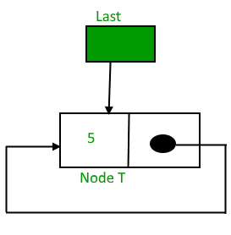
After inserting a node A,
“A”
Node A

Slide 21
Implementing Circular Linked List
Implementing a circular linked list is very easy
And almost similar to linear linked list implementation,
With the only difference being that,
In circular linked list the last Node will have it's next point to the Head of the List.
In Linear linked list the last Node simply holds NULL in it's next pointer.
So this will be our Node class,
As we have already studied in the lesson
it will be used to form the List.

Slide 22
The actual implementation contains:
Two pointers as head and tail and the tail pointers internally point to the head node.
Below is our implementation class.
public class CircularLinkedList {
public class Node {
private int data;
private Node nextNode;
}
}

